Slide 1

HARAMAYA UNIVERSITY
COLLEGE OF COMPUTING AND INFORMATICS
DEPARTMENT OF SOFTWARE ENGINEERING
PYTHON PROJECT
Scientific Calculator
NAME : LETERA TUJO ID_NO : 0677/15

Slide 2
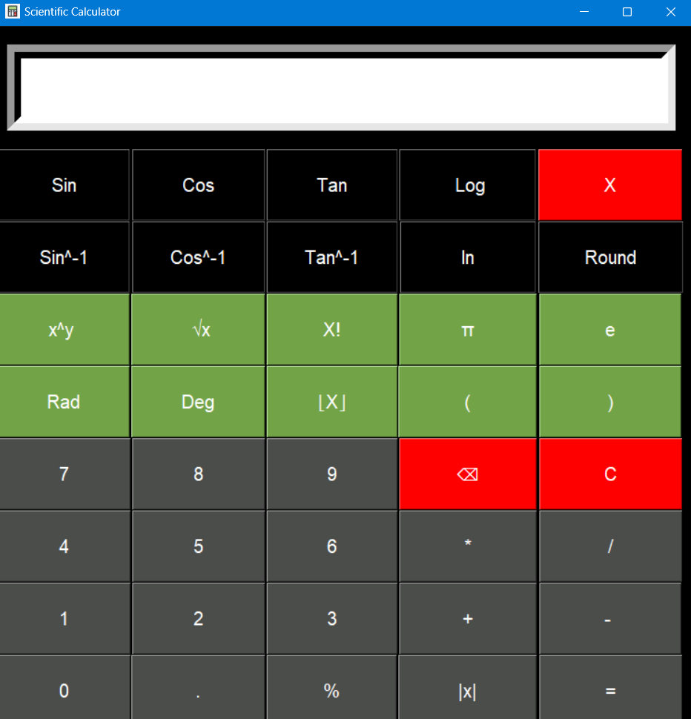
The Design of my calculator

Slide 3
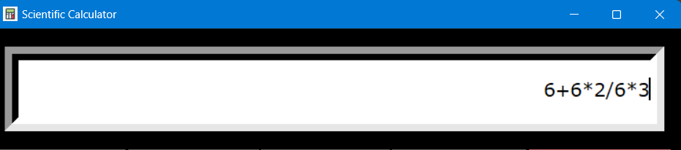
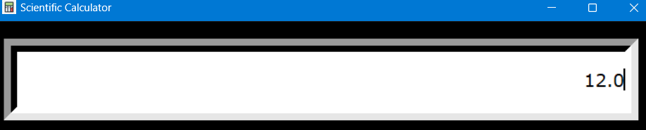
What Things our calculator can do :
It can solve simple calculations as well as trigonometric :

Slide 4
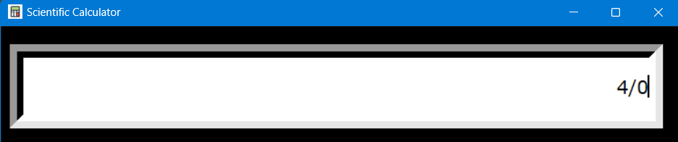
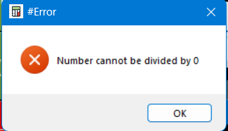
Specialties :
We think specialty in our calculator is that whenever you will make a syntax error, it will tell you and get you back where you were.

Slide 5
How we started to make it :
We started making calculator by making its logic first that how its going to work.
Button pressed
Function calling
results

Slide 6
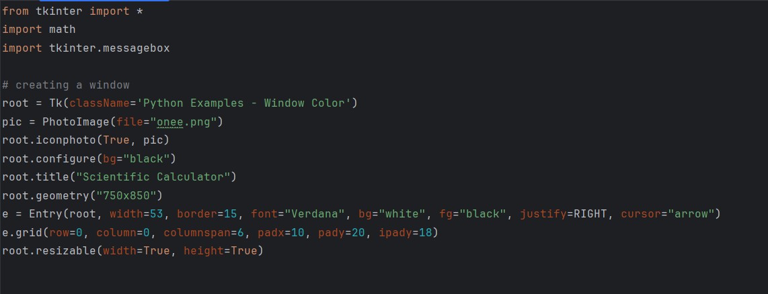
Importing “Tkinter” and “Math” module and a “Message box”:
Here we defined the making of “entry” grid where all our values would show. We gave it a specific size, border, font, background, foreground, “Right” alignment and an “Arrow” cursor. We added an image on bottom right of the buttons and at the top left of the window. We also made the window fixed.

Slide 7
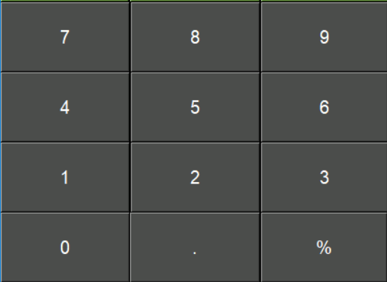
Then we started making buttons and implementing the functions we are going to create :
But1 = Button(root, text="1", padx=59, pady=20, bg="#4b4d4b", fg="white", font="5", command=lambda: cal.butclick(1)) But2 = Button(root, text="2", padx=59, pady=20, bg="#4b4d4b", fg="white", font="5", command=lambda: cal.butclick(2)) But3 = Button(root, text="3", padx=58, pady=20, bg="#4b4d4b", fg="white", font="5", command=lambda: cal.butclick(3)) But4 = Button(root, text="4", padx=59, pady=20, bg="#4b4d4b", fg="white", font="5", command=lambda: cal.butclick(4)) But5 = Button(root, text="5", padx=59, pady=20, bg="#4b4d4b", fg="white", font="5", command=lambda: cal.butclick(5)) But6 = Button(root, text="6", padx=58, pady=20, bg="#4b4d4b", fg="white", font="5", command=lambda: cal.butclick(6)) But7 = Button(root, text="7", padx=59, pady=20, bg="#4b4d4b", fg="white", font="5", command=lambda: cal.butclick(7)) But8 = Button(root, text="8", padx=59, pady=20, bg="#4b4d4b", fg="white", font="5", command=lambda: cal.butclick(8)) But9 = Button(root, text="9", padx=58, pady=20, bg="#4b4d4b", fg="white", font="5", command=lambda: cal.butclick(9)) But0 = Button(root, text="0", padx=59, pady=20, bg="#4b4d4b", fg="white", font="5", command=lambda: cal.butclick(0))

Slide 8
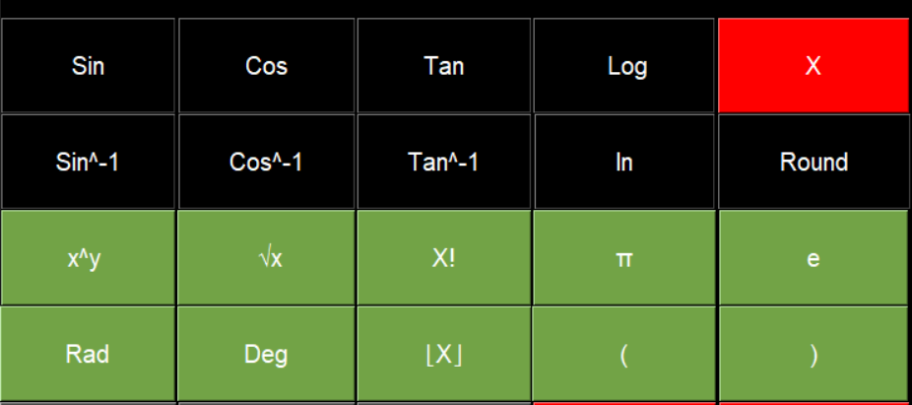
And then implemented their position by using grid() function :
Butcos.grid(row=1, column=1) Butlog.grid(row=1, column=3) Butsin.grid(row=1, column=0) Buttan.grid(row=1, column=2) But_close.grid(row=1, column=4) # row2 Butln.grid(row=2, column=3) Butround.grid(row=2, column=4) Butinsin.grid(row=2, column=0) Butintan.grid(row=2, column=2) Butincos.grid(row=2, column=1) # Row3 Bute.grid(row=3, column=4) Butpi.grid(row=3, column=3) Butsqrt.grid(row=3, column=1) Butfact.grid(row=3, column=2) Butpower.grid(row=3, column=0)

Slide 9
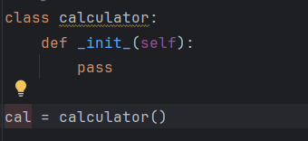
Making of a class:
After positioning, we implemented a class function “calculator:” and passed the keyword ‘self’ in all the functions inside the calculator class so the Functions can use the attributes and methods of the class.
We stored the class “calculator()” in a variable “cal”.

Slide 10
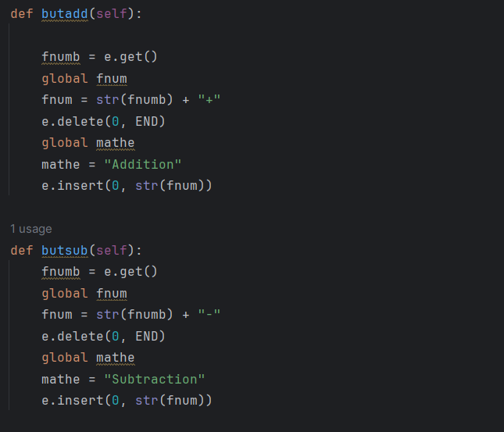
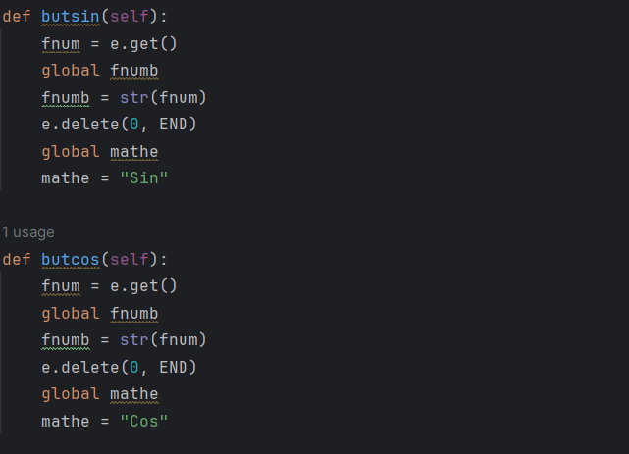
After positioning we created (defined) functions that the buttons would perform :

Slide 11
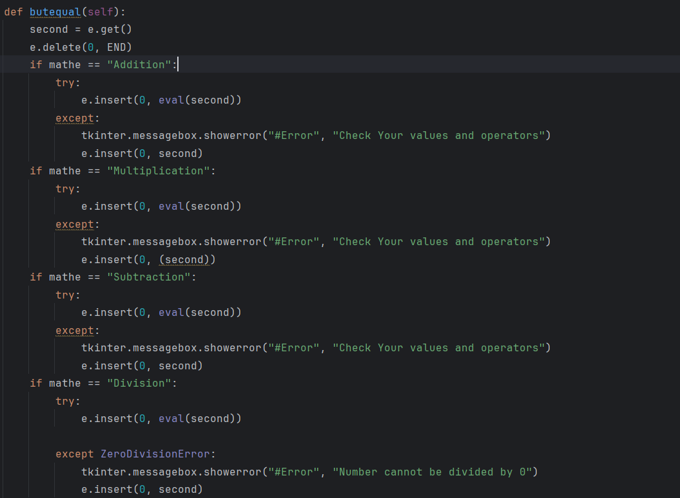
We linked all functions with the Equal button so when the user is done with the input and clicked equal’ the equal function will recognize the input and will perform those actions and will show the output on screen.
Addition
Subtracion
Division
Multiplication
And many more.

Slide 12
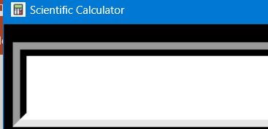
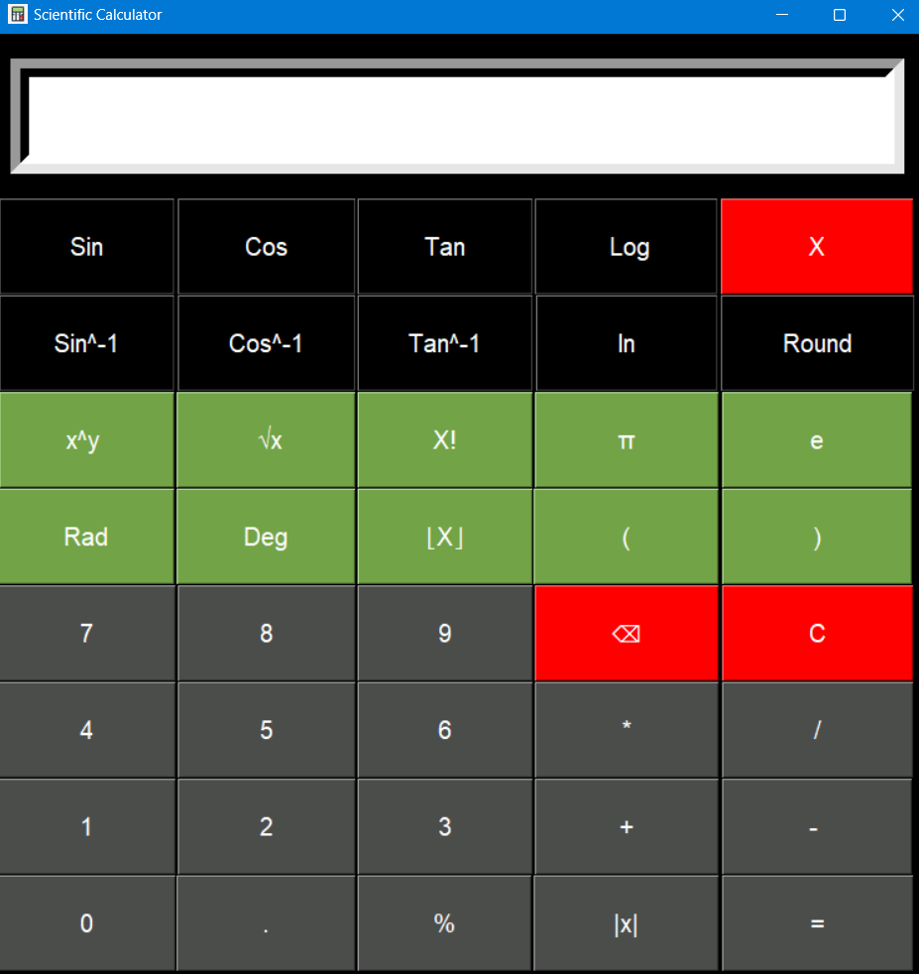

And in last we added a picture on the corner of calculator/window and also changed the icon of the calculator :
For icon : iconphoto function used.
Corner image : First I got the image from storage and implemented it in a button and disabled the button.

Slide 13
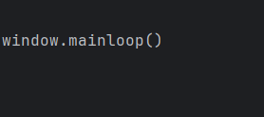
And in last we ended with the “mainloop( )” So our calculator or window can run as long as we don’t quit it.

Slide 14
Thanks for being here.

